Slide 1

Utility
Manager
Reportings, Ratings, Recognition

Slide 2
Who We Are
Miles Crabbe
Ethan Downey
Chad Easter

Slide 3
Objectives
Provide (nearly) real-time outage data
Utilize crowd-sourced data and provider data
Provide outage histories and ratings for Utility Companies and Customers
Create an enjoyable, streamlined customer service experience

Slide 4
Motivation
Public Service
Personal Interest
(Chad still doesn’t have internet)
Personal Experience
Reduced downtime of essential utilities
Possible entry point for lucrative projects

Slide 5
Competition
Limited in scope, regional or by city
Most focus on electrical outages
Few server-based data sources
Lack of user provided data
Lack of a unifying app for all utilities and services

Slide 6
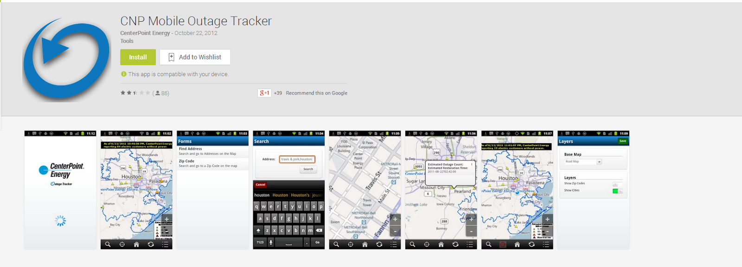
Competition Cont.

Slide 7
Why We Will Be Different
Focus on an enjoyable user experience
Offer a wide scope of utilities and companies
Various ways to visualize the data
Unify all utilities under our app

Slide 8
Expandability
Server based data allows for easily expandable data sets, no app update required to introduce new data
All data could easily be transformed from mobile optimized to a website based system

Slide 9
Specialization
Creation of company specific apps would be as easy as changing a few variables
Could assist company in diagnosing problems
Companies can monitor response rate of their employees

Slide 10

Monetization
Access to the app’s data
Company specific versions of the app (companies pay for our service)
Web based monitoring system
Pro version of the public facing app
Customizations
More in-depth comparisons

Slide 11

Cost
Software development costs
Mapping costs
Server hosting
In-house vs hosted servers
Possible use of Cloud Computing

Slide 12
Infrastructural limitations
Internet connection required but is accessible via WiFi or cellular signal.
Cellular reporting would be more common due to power outages affecting LANs
During storms, this would not be a time of event tool, but more an aftermath clean-up tool
Lack of mapping data may make it difficult to pinpoint the source of an outage

Slide 13
Conclusion
Utility Manager allow users to report outages and problems with their utility services in a direct, streamlined manner.
Utility Manager allows users to see live and planned outages.
Utility Manager allows users to base their utility company choice on statistics and reviews of that company’s service.
Utility Manager does this for all utilities in one interface.

